Slide 1











Word Embeddings Analytics for Unstructured Data MSBA, Fall 2021 16th September
Dr. Anitesh Barua
David Bruton Jr. Centennial Chair Professor in Business
Distinguished Fellow, INFORMS Information Systems Society
University of Texas Distinguished Teaching Professor
Associate Director, Center for Research in e-Commerce
McCombs School of Business, University of Texas at Austin
Email: aniteshb@gmail.com
Slides based on:
https://www.shanelynn.ie/get-busy-with-word-embeddings-introduction/
https://jalammar.github.io/illustrated-word2vec/?fbclid=IwAR2CW3N9udeCAboUE_PtHM5rCjY6vCgNGwx3DUE76boVHMEl0MqJigVIBdc
https://web.stanford.edu/class/cs224n/materials/Gensim%20word%20vector%20visualization.html

Slide 2
Word Embeddings
Every word can be represented by a vector of real numbers
Word embeddings are n-dimensional vectors (n has to be chosen)
Word vectors of a vocabulary should capture
the relationship between words
the context of different words
Embeddings are between 50 and 500 in length
Similar words end up with similar embedding values.
Source: https://www.shanelynn.ie/get-busy-with-word-embeddings-introduction/

Slide 3
One-hot Encoding
Also called “1-of-N” encoding
Embedding space has the same number of dimensions as the number of words in the vocabulary
Each embedding is predominantly made up of zeros, with a “1” in the corresponding dimension for the word
Source: https://www.shanelynn.ie/get-busy-with-word-embeddings-introduction/

Slide 4
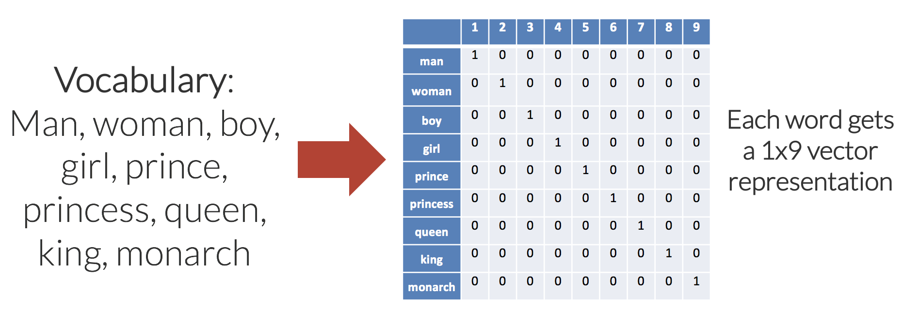
One-hot Encoding for a 9-word Vocabulary
Issues with this approach?
Source: https://www.shanelynn.ie/get-busy-with-word-embeddings-introduction/

Slide 5
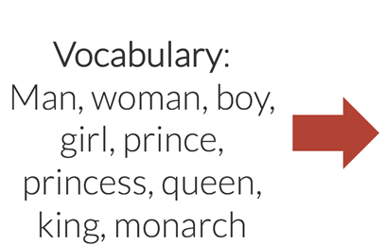
Reducing Dimensionality: Custom Embeddings
Goals:
Reduce dimensionality
Similar words → similar vectors
 | Feminine | Youth | Royalty
Man
Woman
Boy
Girl
Prince
Princess
Queen
King
Royalty
Each word will have 1x3 vector representation
Source: https://www.shanelynn.ie/get-busy-with-word-embeddings-introduction/

Slide 6
Advantages of the New Encoding?

Slide 7
Larger Vocabularies
Creating n-dimensional vectors from large corpus
Manual assignment of vectors not possible
Word embeddings should have hundreds of dimensions
Vector values can be assigned in a variety of ways (including prediction, which is most useful)
Algorithms take large bodies of text and create embeddings
Word2Vec (Mikolov et al., Google), GloVe (Stanford) & fastText (Facebook)
Source: https://www.shanelynn.ie/get-busy-with-word-embeddings-introduction/

Slide 8
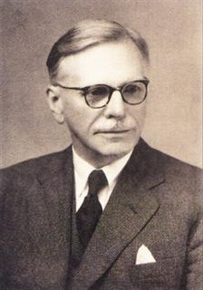
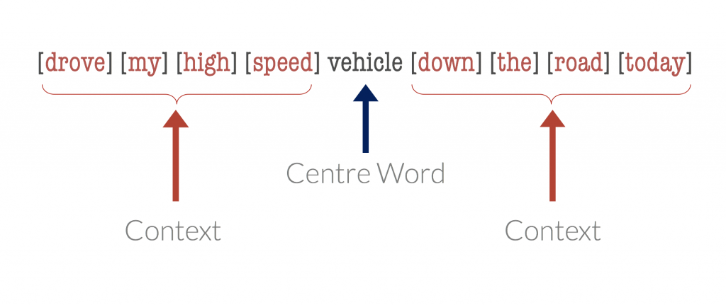
Automating Word Vector Generation
“You shall know a word by the company it keeps” (Firth, 1957)
John Rupert Firth
Center word

Slide 9
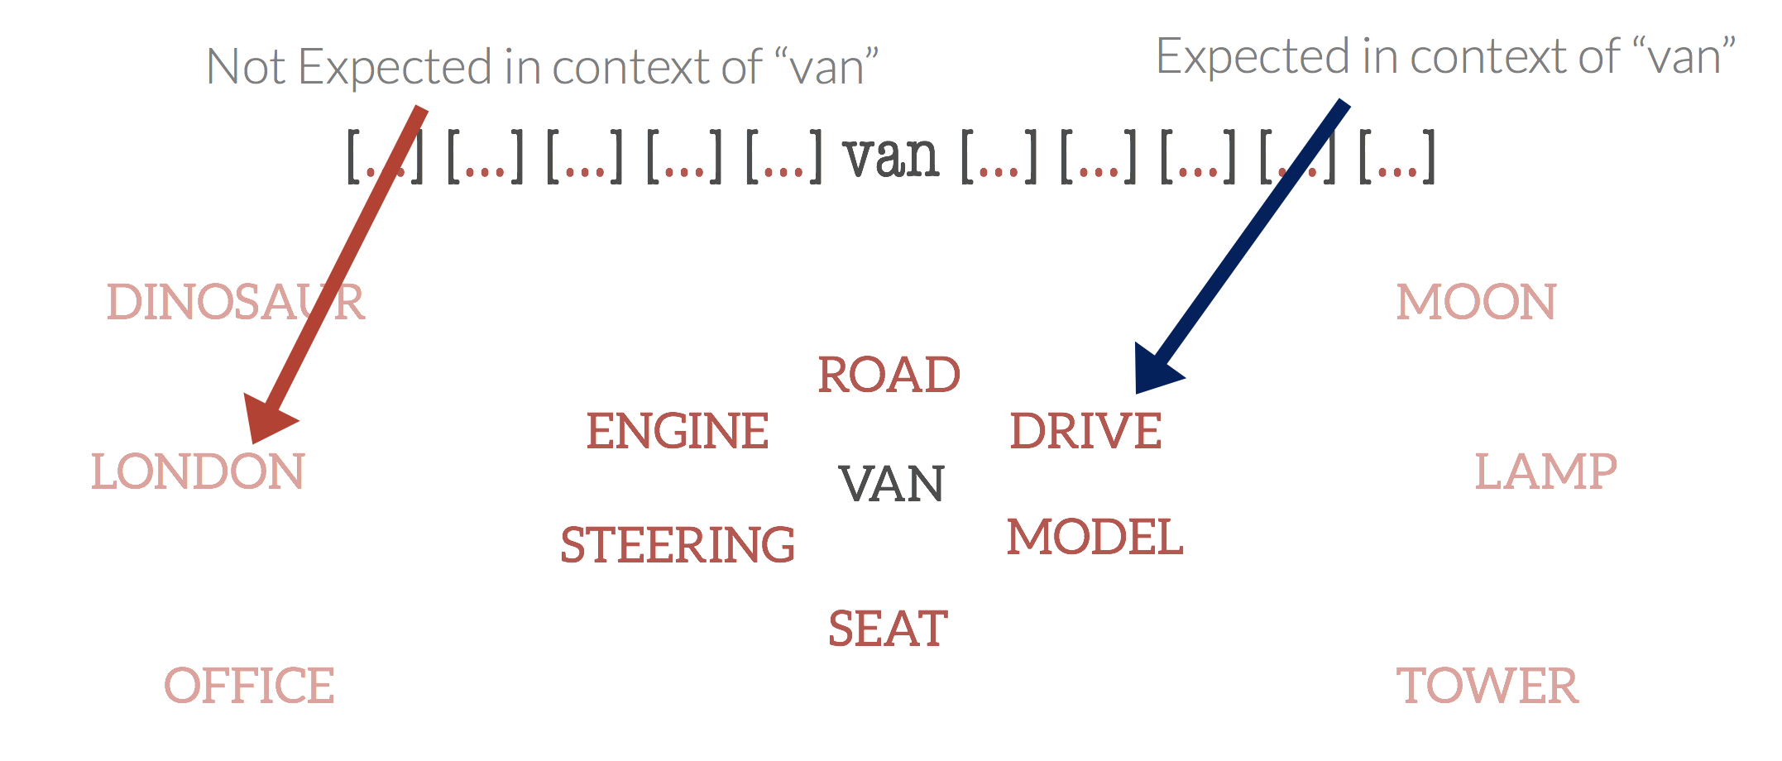
Given a Center Word, Find Context Words

Slide 10
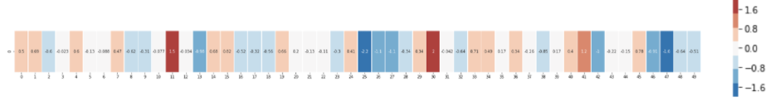
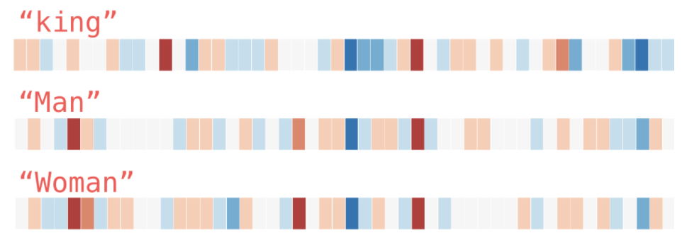
Pre-trained Word Embeddings
The 50-dimensional Glove embeddings for “king”
[0.50451 , 0.68607 , -0.59517 , -0.022801, 0.60046 , -0.13498 , -0.08813 , 0.47377 , -0.61798 , -0.31012 , -0.076666, 1.493 , -0.034189, -0.98173 , 0.68229 , 0.81722 , -0.51874 , -0.31503 , -0.55809 , 0.66421 , 0.1961 , -0.13495 , -0.11476 , -0.30344 , 0.41177 , -2.223 , -1.0756 , -1.0783 , -0.34354 , 0.33505 , 1.9927 , -0.04234 , -0.64319 , 0.71125 , 0.49159 , 0.16754 , 0.34344 , -0.25663 , -0.8523 , 0.1661 , 0.40102 , 1.1685 , -1.0137 , -0.21585 , -0.15155 , 0.78321 , -0.91241 , -1.6106 , -0.64426 , -0.51042]
The numbers are weights in the neural network used for training (details coming up!)
Source: https://jalammar.github.io/illustrated-word2vec/?fbclid=IwAR2CW3N9udeCAboUE_PtHM5rCjY6vCgNGwx3DUE76boVHMEl0MqJigVIBdc

Slide 11
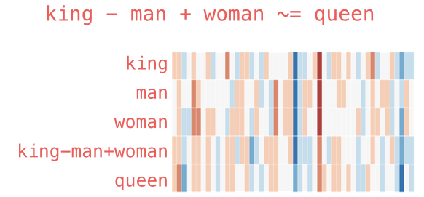
Vector Addition and Subtraction: The Case of Analogies
Source: https://jalammar.github.io/illustrated-word2vec/?fbclid=IwAR2CW3N9udeCAboUE_PtHM5rCjY6vCgNGwx3DUE76boVHMEl0MqJigVIBdc

Slide 12
Language Models
Fill in the blank
She was driving a ____
Would your answer change for
She was driving a ____ red Ferrari
Words to both left and right of a center word have informational value
Window of size 5 (just an example)
Driving | a | cool | red | Ferrari
Input 1 | Input 2 | Input 3 | Input 4 | Output (center word)
Driving | a | red | Ferrari | cool
Continuous Bag of Words (CBOW): Given the context words, predict the center word
Source: https://jalammar.github.io/illustrated-word2vec/?fbclid=IwAR2CW3N9udeCAboUE_PtHM5rCjY6vCgNGwx3DUE76boVHMEl0MqJigVIBdc

Slide 13
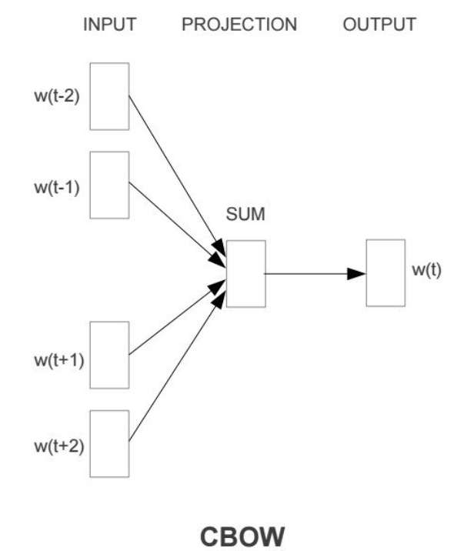
Continuous Bag of Words (CBOW)
Predict w(t)

Slide 14
Another Model: Skip-gram
Driving | a | cool | red | Ferrari
Input | Output (context words)
cool | Driving
cool | a
cool | red
cool | Ferrari
Two words to the left and right of a center word (just an example)
Skip-gram: Given the center word, predict the context words
Source: https://jalammar.github.io/illustrated-word2vec/?fbclid=IwAR2CW3N9udeCAboUE_PtHM5rCjY6vCgNGwx3DUE76boVHMEl0MqJigVIBdc

Slide 15
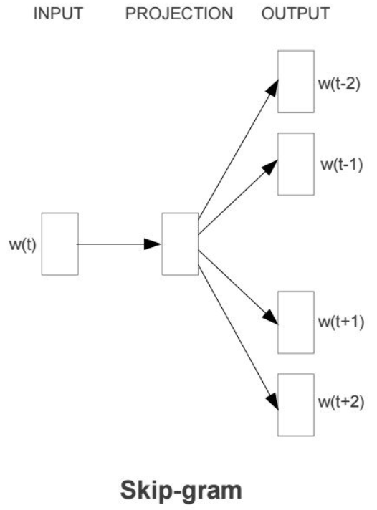
The Skip-gram Model

Slide 16
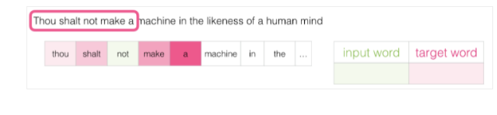
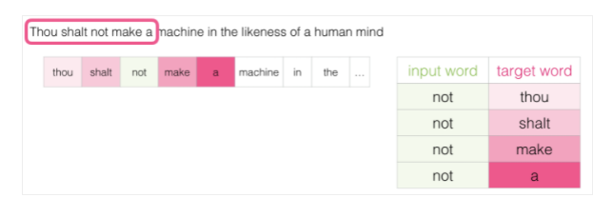
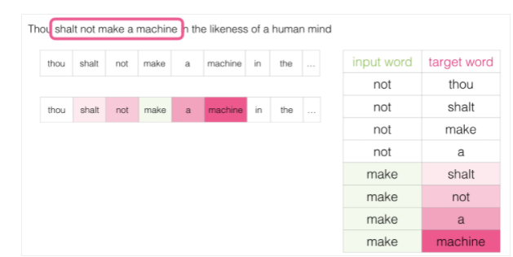
The Sliding Window
Source: https://jalammar.github.io/illustrated-word2vec/?fbclid=IwAR2CW3N9udeCAboUE_PtHM5rCjY6vCgNGwx3DUE76boVHMEl0MqJigVIBdc

Slide 17
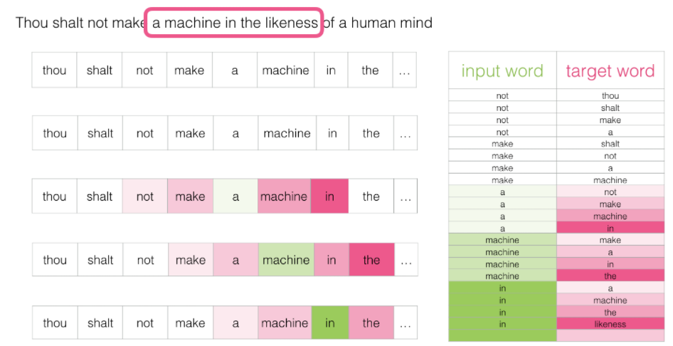
After Sliding Over Several Words
Source: https://jalammar.github.io/illustrated-word2vec/?fbclid=IwAR2CW3N9udeCAboUE_PtHM5rCjY6vCgNGwx3DUE76boVHMEl0MqJigVIBdc

Slide 18
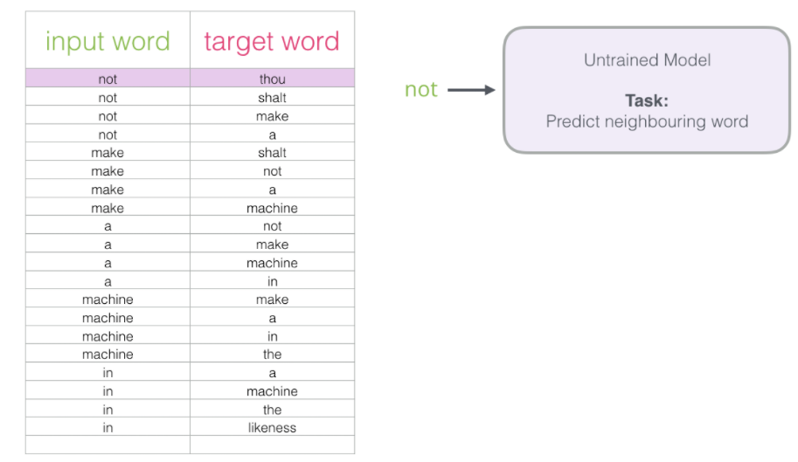
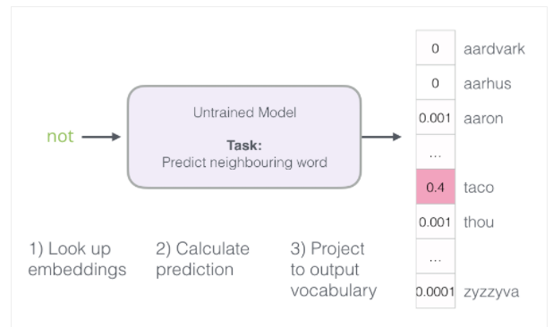
Start the Training
Source: https://jalammar.github.io/illustrated-word2vec/?fbclid=IwAR2CW3N9udeCAboUE_PtHM5rCjY6vCgNGwx3DUE76boVHMEl0MqJigVIBdc

Slide 19
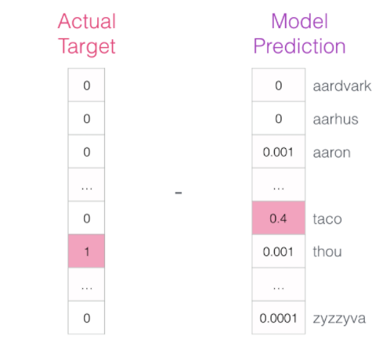
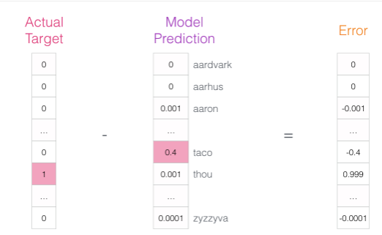
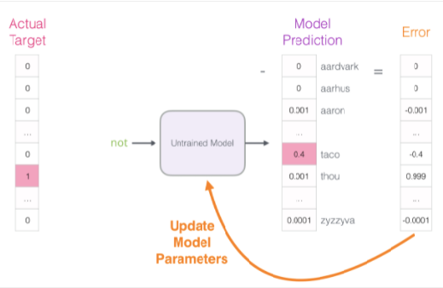
Updating Model Parameters
Source: https://jalammar.github.io/illustrated-word2vec/?fbclid=IwAR2CW3N9udeCAboUE_PtHM5rCjY6vCgNGwx3DUE76boVHMEl0MqJigVIBdc

Slide 20
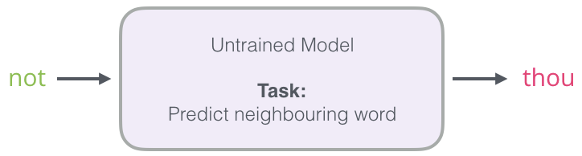
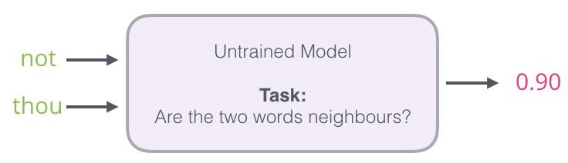
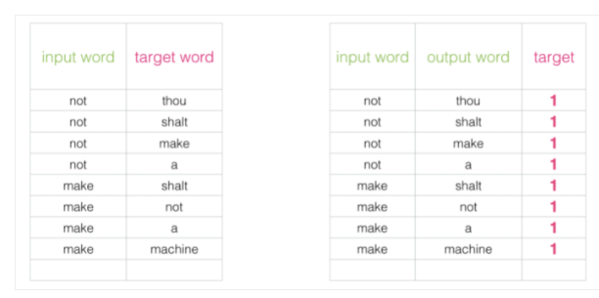
Increase the Efficiency of the Model
From
To
Source: https://jalammar.github.io/illustrated-word2vec/?fbclid=IwAR2CW3N9udeCAboUE_PtHM5rCjY6vCgNGwx3DUE76boVHMEl0MqJigVIBdc

Slide 21
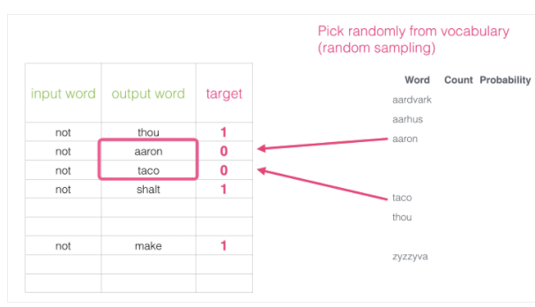
Negative Sampling
The problem
The solution
Source: https://jalammar.github.io/illustrated-word2vec/?fbclid=IwAR2CW3N9udeCAboUE_PtHM5rCjY6vCgNGwx3DUE76boVHMEl0MqJigVIBdc

Slide 22
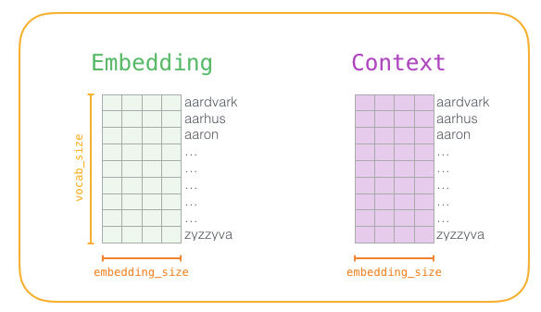
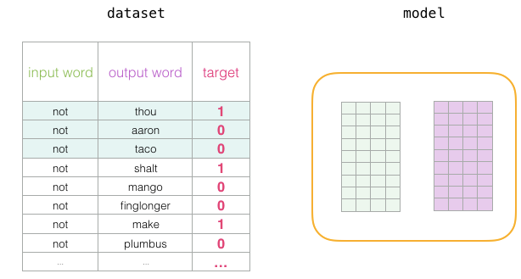
All Set for Training
Source: https://jalammar.github.io/illustrated-word2vec/?fbclid=IwAR2CW3N9udeCAboUE_PtHM5rCjY6vCgNGwx3DUE76boVHMEl0MqJigVIBdc

Slide 23
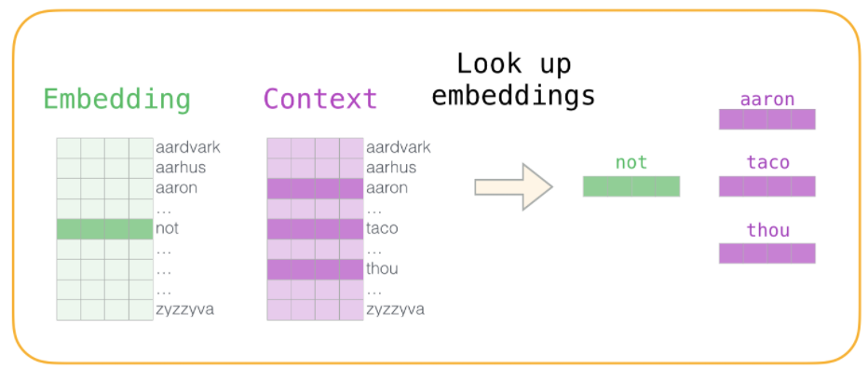
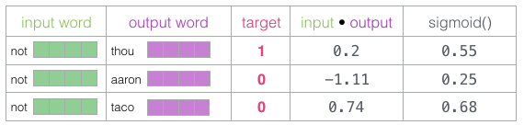
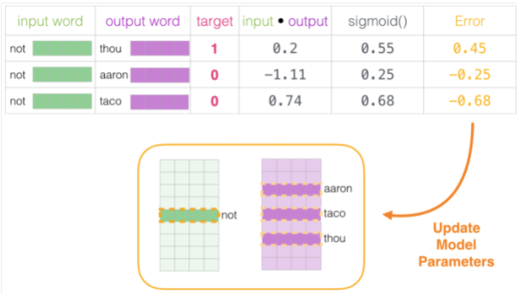
The Training Process
Source: https://jalammar.github.io/illustrated-word2vec/?fbclid=IwAR2CW3N9udeCAboUE_PtHM5rCjY6vCgNGwx3DUE76boVHMEl0MqJigVIBdc

Slide 24
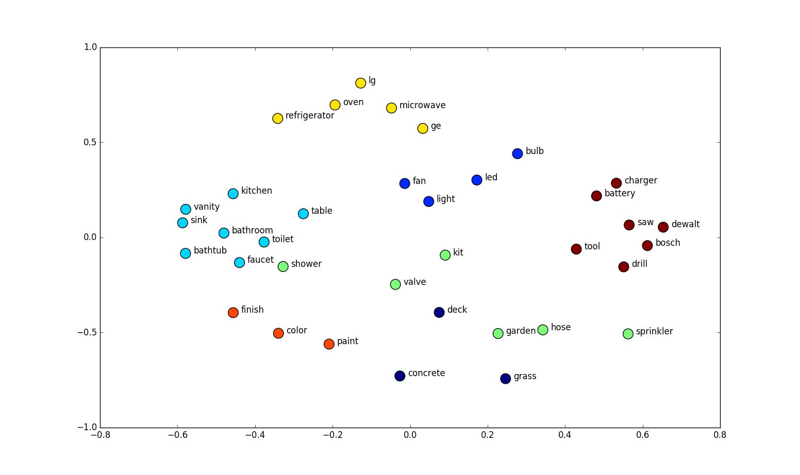
Word Similarities
In trained word vectors, similar words will be close to each other
Similarity can be calculated by Euclidean distance or cosine similarity of word vectors

Slide 25
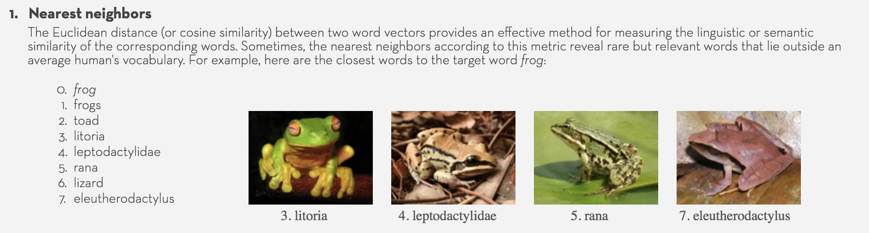
Discovery of “New” Words

Slide 26
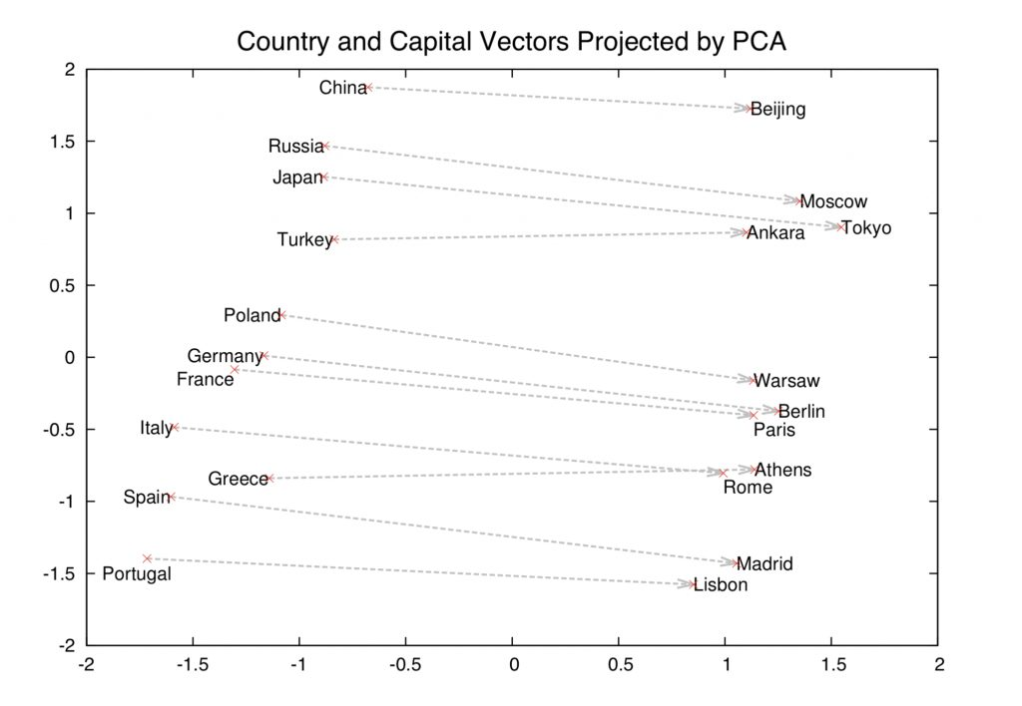

Slide 27
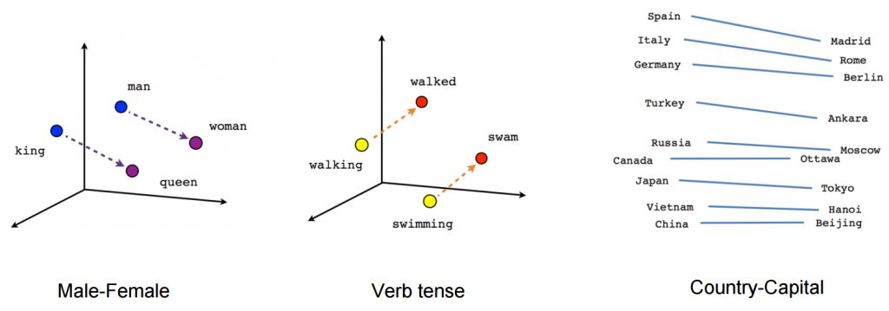
Discovering Relationships from Corpus

Slide 28
“Automatic Extraction of Features of Mobile Apps from Version Release Notes” (Karanam, Agarwal and Barua, 2019)
Automatic feature extraction is challenging!
“Greatly improved Voice Over support for visually impaired users. - Retina display support for iPhone & iPad - User interface improvements. Added a recording signal meter - Support for system and remote - Control of media playback and recording such as lock screen, and system media controls.”

Slide 29
Challenges & Solutions
Challenges | Solution
Bi- & tri-gram features: Representing the order of feature words | BIOES tagging
No external dictionaries (different names for same features) | Custom word embeddings: Skip-gram with negative sampling (Mikolov et al. 2013) for all words in our corpus
Large number of sentences without features! | Sentence classifier (BiLSTM)
Learning the order of feature words | BiLSTM-Conditional Random Fields (CRF)

Slide 30
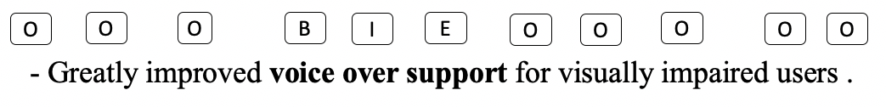
Feature Extraction: BIOES Tagging
BIOES format (Ratinov and Roth 2009) to represent the order of words

Slide 31
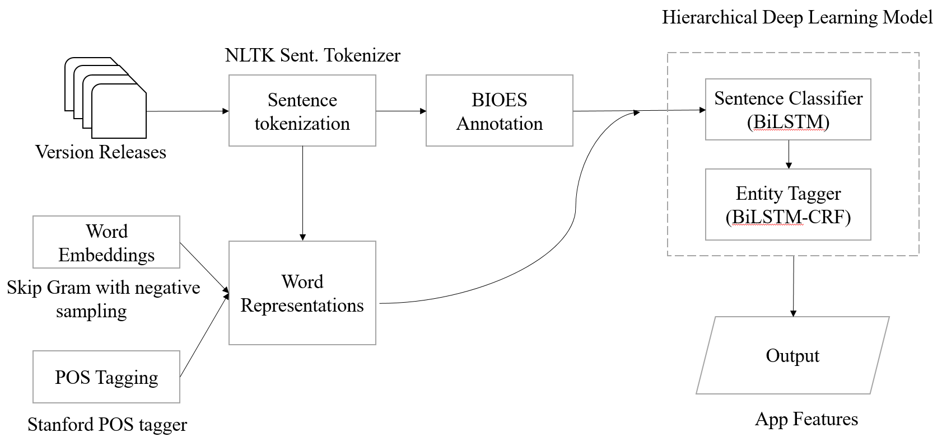
Flowchart of Our Feature Extraction Procedure
Character Embeddings
Notes:
We use character level embeddings of a word along with word embeddings for three major reasons. One, developers name features using alphanumeric and special characters. For instance, words like g+, 3d touch, 3g, 4g, etc. are used as features of an app. Second, developers may provide unique names for app features, and word embeddings are well equipped in handling frequently observed words. Third, word forms or linguistic information like prefix and suffix notation of a word would have information in identifying the feature words. For example, ‘browser’ is a feature word, but ‘browse’ is a non-feature word. We use character embeddings to overcome these challenges.

Slide 32

“Us and Them”
Method | f1 | Precision | Recall | Comments
Noun & verb phrase extraction | 19.7% | 39.1% | 34.3%
BiLSTM (Liu et al. 2019) | 40.5% | 45.9% | 47.4% | Not suited for bi- and tri-grams
BiLSTM-CRF | 57.6% | 65.4% | 51.5% | Non-feature sentences pose challenge
Our approach (hierarchical) | 75.5% | 70.5% | 81.3% | Works well with our noisy & sparse data

Slide 33
Comparing Feature Extraction Results
App | Version Release Notes | Actual Features | Predicted Features (Our Approach) | Predicted Features (BiLSTM)
irecorder-pro-audio-recorder (version: 3.1) | - Greatly improved Voice Over support for visually impaired users. - Retina display support for iPhone & iPad - User interface improvements. Added a recording signal meter - Support for system and remote - Control of media playback and recording such as on lock screen, and system media controls. | (‘voice over support’, 'retina display', 'user interface', 'recording signal meter', 'media playback', ‘recording’, ‘lock screen’, 'media controls') | (‘voice over support’, ‘visually impaired users’, 'retina display', 'user interface', 'recording signal meter', 'media playback', 'lock screen', 'media controls') | (‘support’, ‘users’, ‘display', ’support’ ‘interface', ‘signal’, 'media’, ‘playback', ‘recording’, 'screen', 'media')
Yammer (Version: 6.5.14) | We are constantly making small fixes and improvements to the app, and, as always, many bugs were crushed during the creation of this release. Thanks for letting us know when things go wrong! Keep up the good work. We know we will.
Notes:
Hierarchical DL result:
‘Visually impaired users’, is predicted as a feature – false positive.
‘on lock screen’ – is not counted as a feature. Since it does not completely over lap with ‘lock screen’
It also misses out on ‘recording’
BiLSTM Result:
Except ’recording’, other features predicted by the BiLSTM in this example will be counted as a feature. Since, the annotated features span more than one word we look at the exact match of the words in the annotated version to that of the predicted version.
BiLSTM will be better in predicting one word features like ui, ux, drive, etc. but not two or three word features.

